Slide 1
SNC1P0 – Oct 09 (P3)
Glad To Meet You – Mr. Nestor
Introductions & Attendance
Chemistry – Periodic Table
Colour your personal table
Warm Up Questions
Chemistry – States of Matter
Video: Bill Nye
Upcoming:
T.b.d.

Slide 2
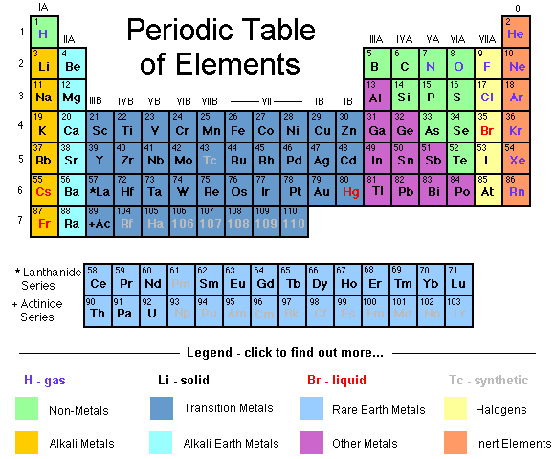

Slide 3
Reading The Periodic Table
Each box on the periodic table represents a different element
It contains vital information about the element
________Number
6 C Carbon 12.011
__________Symbol
Element Name
Atomic ________

Slide 4
Practice:
Warm-up Questions:
Element name for the symbol “P”
Symbol for the element “Potassium”
Atomic number for the symbol “Ag”
Atomic mass for “Gold”

